Slide 1
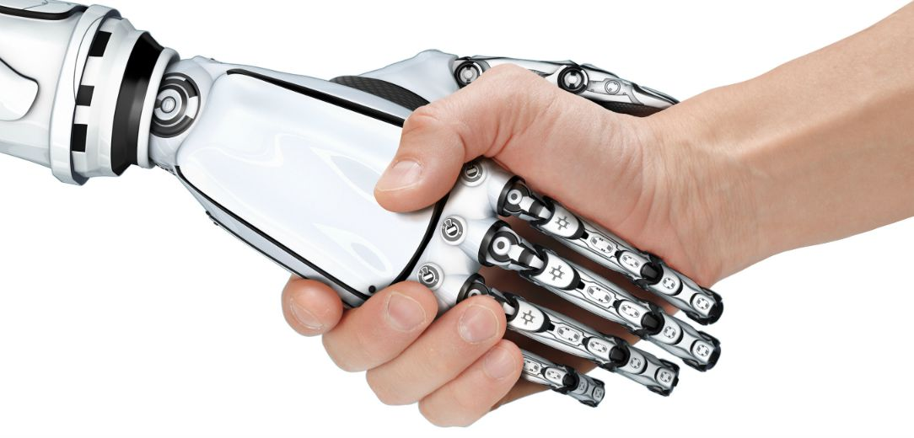
ARTIFICIAL INTELLEGENCE

Slide 2
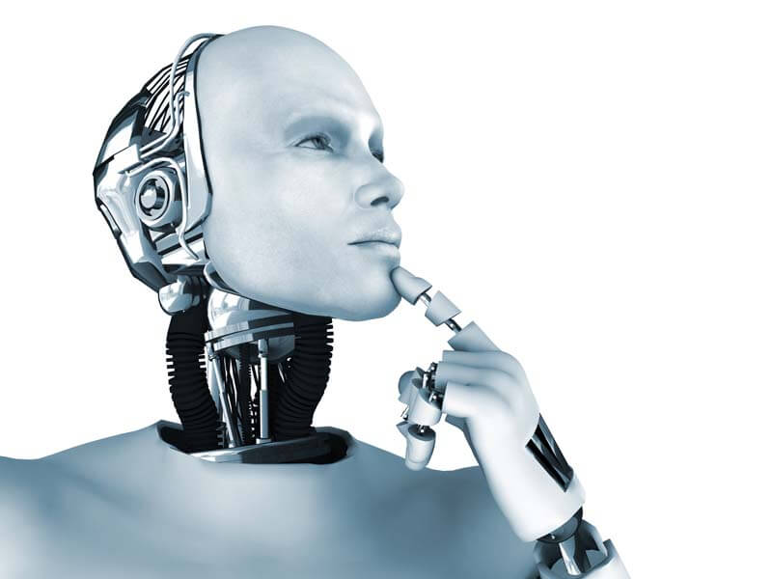
Contents
Introduction
Early History
Current Status of AI
Challenges for AI
Applications
Pros & Cons
Conclusion

Slide 3
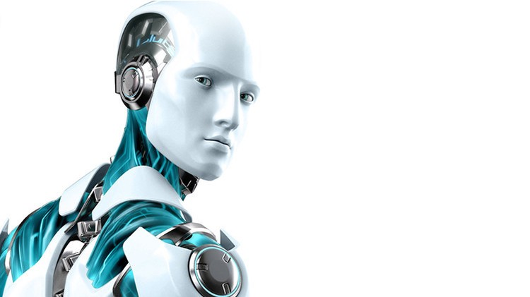

WHAT IS A.I.?
The study of computer systems that attempt to model and apply the intelligence of the human mind.
A branch of computer science dealing with the simulation of intelligent behaviour in computers
The capability of a machine to imitate intelligent human behaviour.

Slide 4
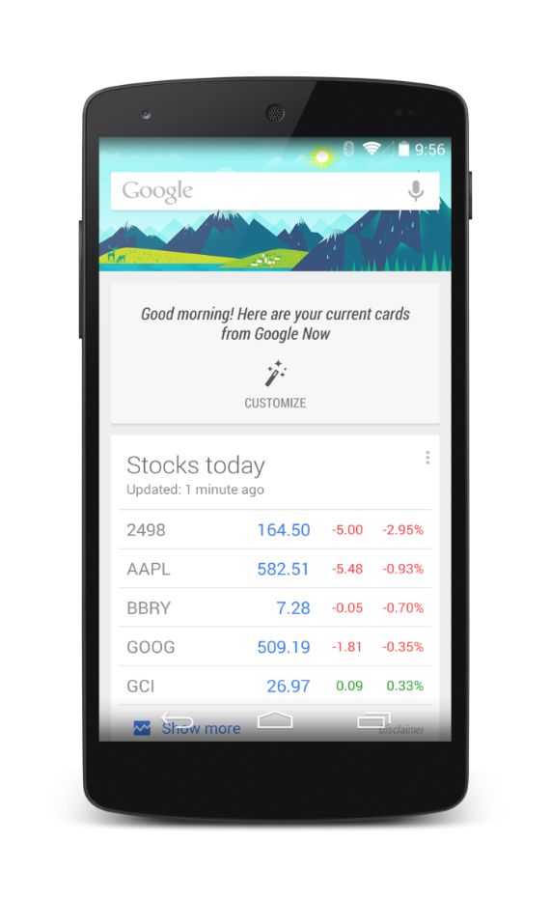
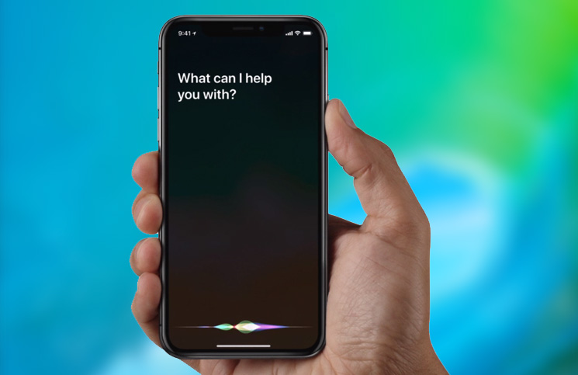
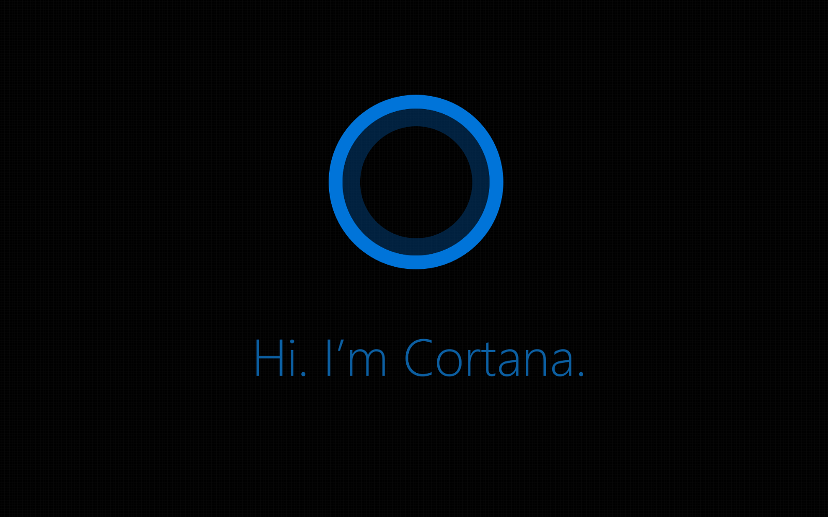
CURRENT STATUS OF AI
Google Now
Siri
Cortana

Slide 5
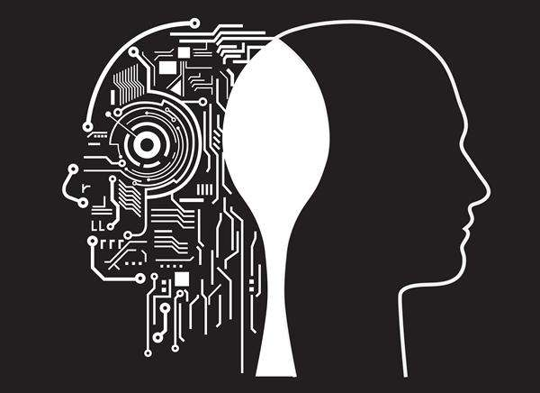
EARLY HISTORY
1950 - Alan Turing
1956 - John McCarthy

Slide 6
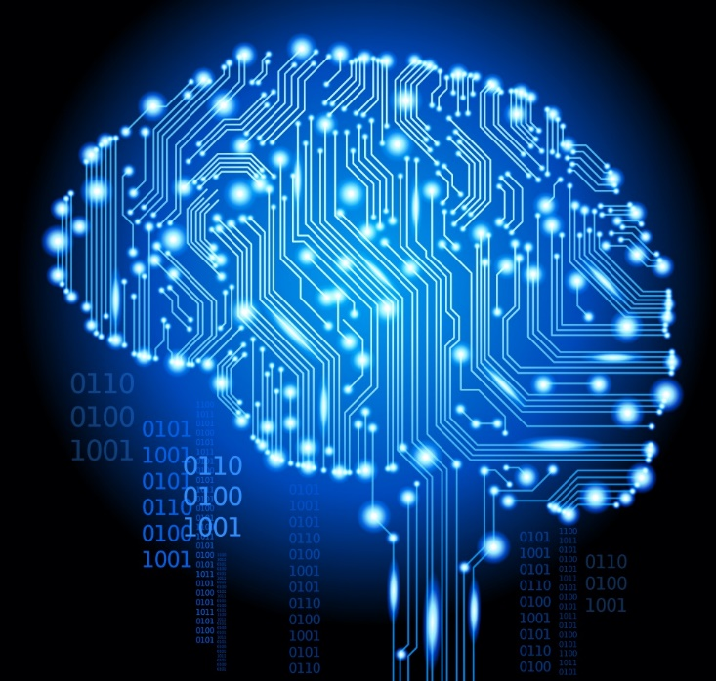
CHALLENGES
• Building trust
• AI human interface
• Investment
• Software malfunction
• AI can’t replace every task
• Higher expectations

Slide 7
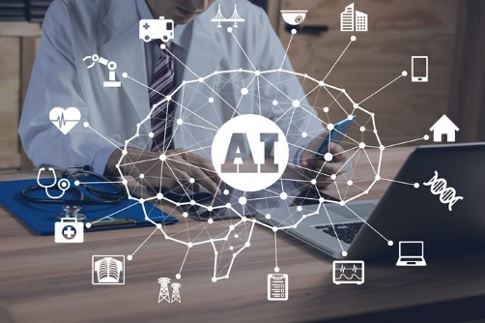
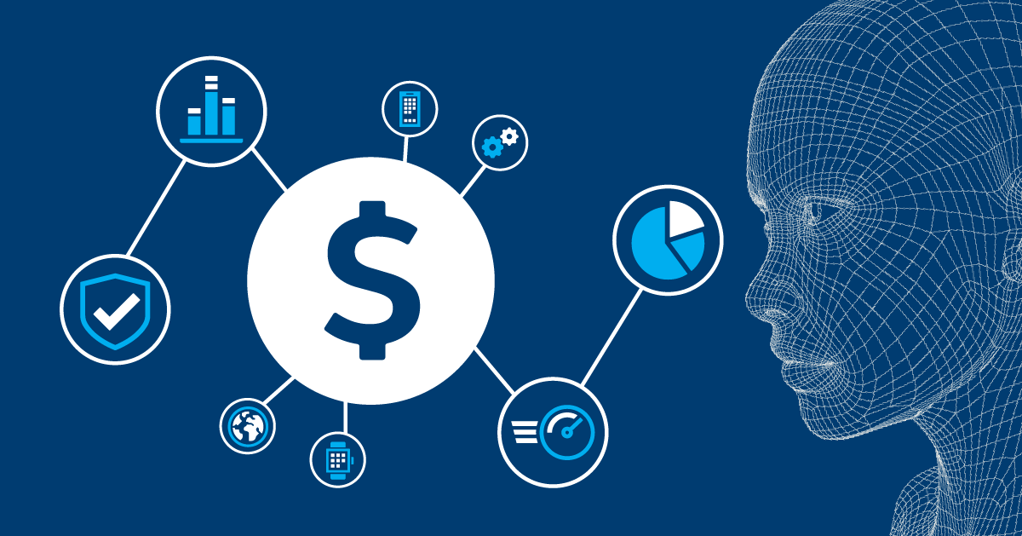
APPLICATIONS
• Computer vision.
• Understanding natural language.
• Game playing.
• Speech recognition.
Transportation

Slide 8
PROS
CONS
Precision and Accuracy
Space exploration
Used for mining process
Can do laborious tasks
Fraud detection, manage records.
Lacking the emotional side
Can do repetitive and time-consuming tasks
Robotic pets, Robotic radiosurgery.
Function without stopping, Risk Reducing.
Diagnosis and Treatment
Cost incurred in the maintenance
Not able to act any different
Lack the human touch
Lack a creative mind
Lack common sense
Unemployment
Abilities of humans may diminish
Robots superseding humans
Humans may became dependent on machines.
Wrong hands causes destruction

Slide 9
CONCLUSION
Emerging use of AI
It will make life easy
Accuracy

Slide 10


Slide 11
ANY QUESTION?

Slide 12
Credits
Kazi Jawwad A Rahim
Gokhale Ashish Rajendra
Khanolkar Ashutosh Ashish
Kiratkar Gunjan Narayan
Naik Aniket Anand
Kadam Sagar Gangaram

Slide 13
THANK YOU !

